Slide 1


Pop-up or moving cards
Mother’s Day

Slide 2
Why do we send cards?

Slide 3
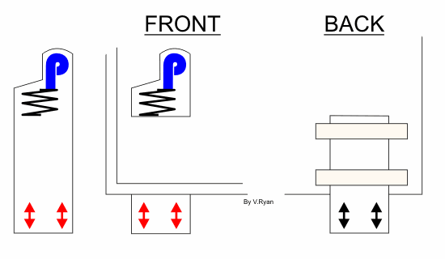
The spring and the letter ‘P’ is drawn on a rectangular piece of card. This is fed through a split in the paper. The card can be moved up and down as shown opposite. It needs to be fixed in place by two thin strips of card on the back.

Slide 4
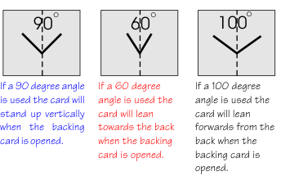
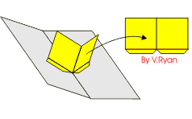
V-FOLD MECHANISMS
V-folding mechanisms are very popular and they are simple to make. Construct the pop-up section by adding tabs to a rectangular piece of card. The tabs are glued to the backing card remembering that the angle must be selected carefully. Draw the angle of bend on the card first before gluing the pop- up piece to it.

Slide 5
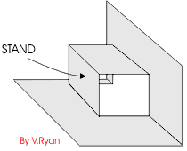
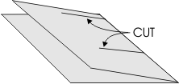
HOW AN INTERNAL STAND MECHANISM CAN BE USED
Interesting pop-up designs can be produced by making two cuts to a backing card and bending the card inwards so that it forms a small stand (inside the card). Drawings / images can be placed on the stand so that when the card is opened the image ‘pops’ up.

Slide 6
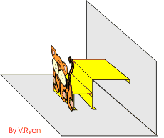
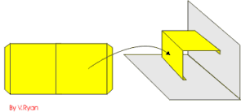
A slightly more difficult pop-up card can be produced by making the stand separately. This can be seen below. Remember to include tabs as these will be the surfaces that are used to glue the stand to the card. The diagram with the tiger image shows a pop-up card that has a small double stand. When the card is opened, the image ‘pops’ up.

Slide 7
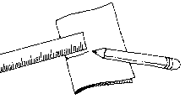
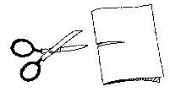
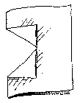
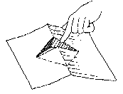
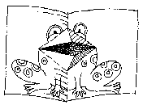
Mouth card
1.) Draw a 5 cm (2 in.) line from the dot towards the outer edge
2.) Starting at the folded edge, cut on the line
3.) Fold back the flaps to form two triangles.
4.) Now comes the tricky part! Hold your paper, so that it looks like a tent. Put your finger on the top triangle and push down. Pinch the two folded edges of the top triangle, so that the triangle is pushed through to the other side of the paper.
5.)Draw a monster, a person or an animal around your mouth

Slide 8
LO: To design and make a Mother’s Day card that involves some kind of mechanism.
Fill in the design sheet for your card.
Using the resources provided make your card.
Don’t forget you need to include at least one pop-up or mechanism (your choice which one)
Use the sheets to help you.

